Slide 1
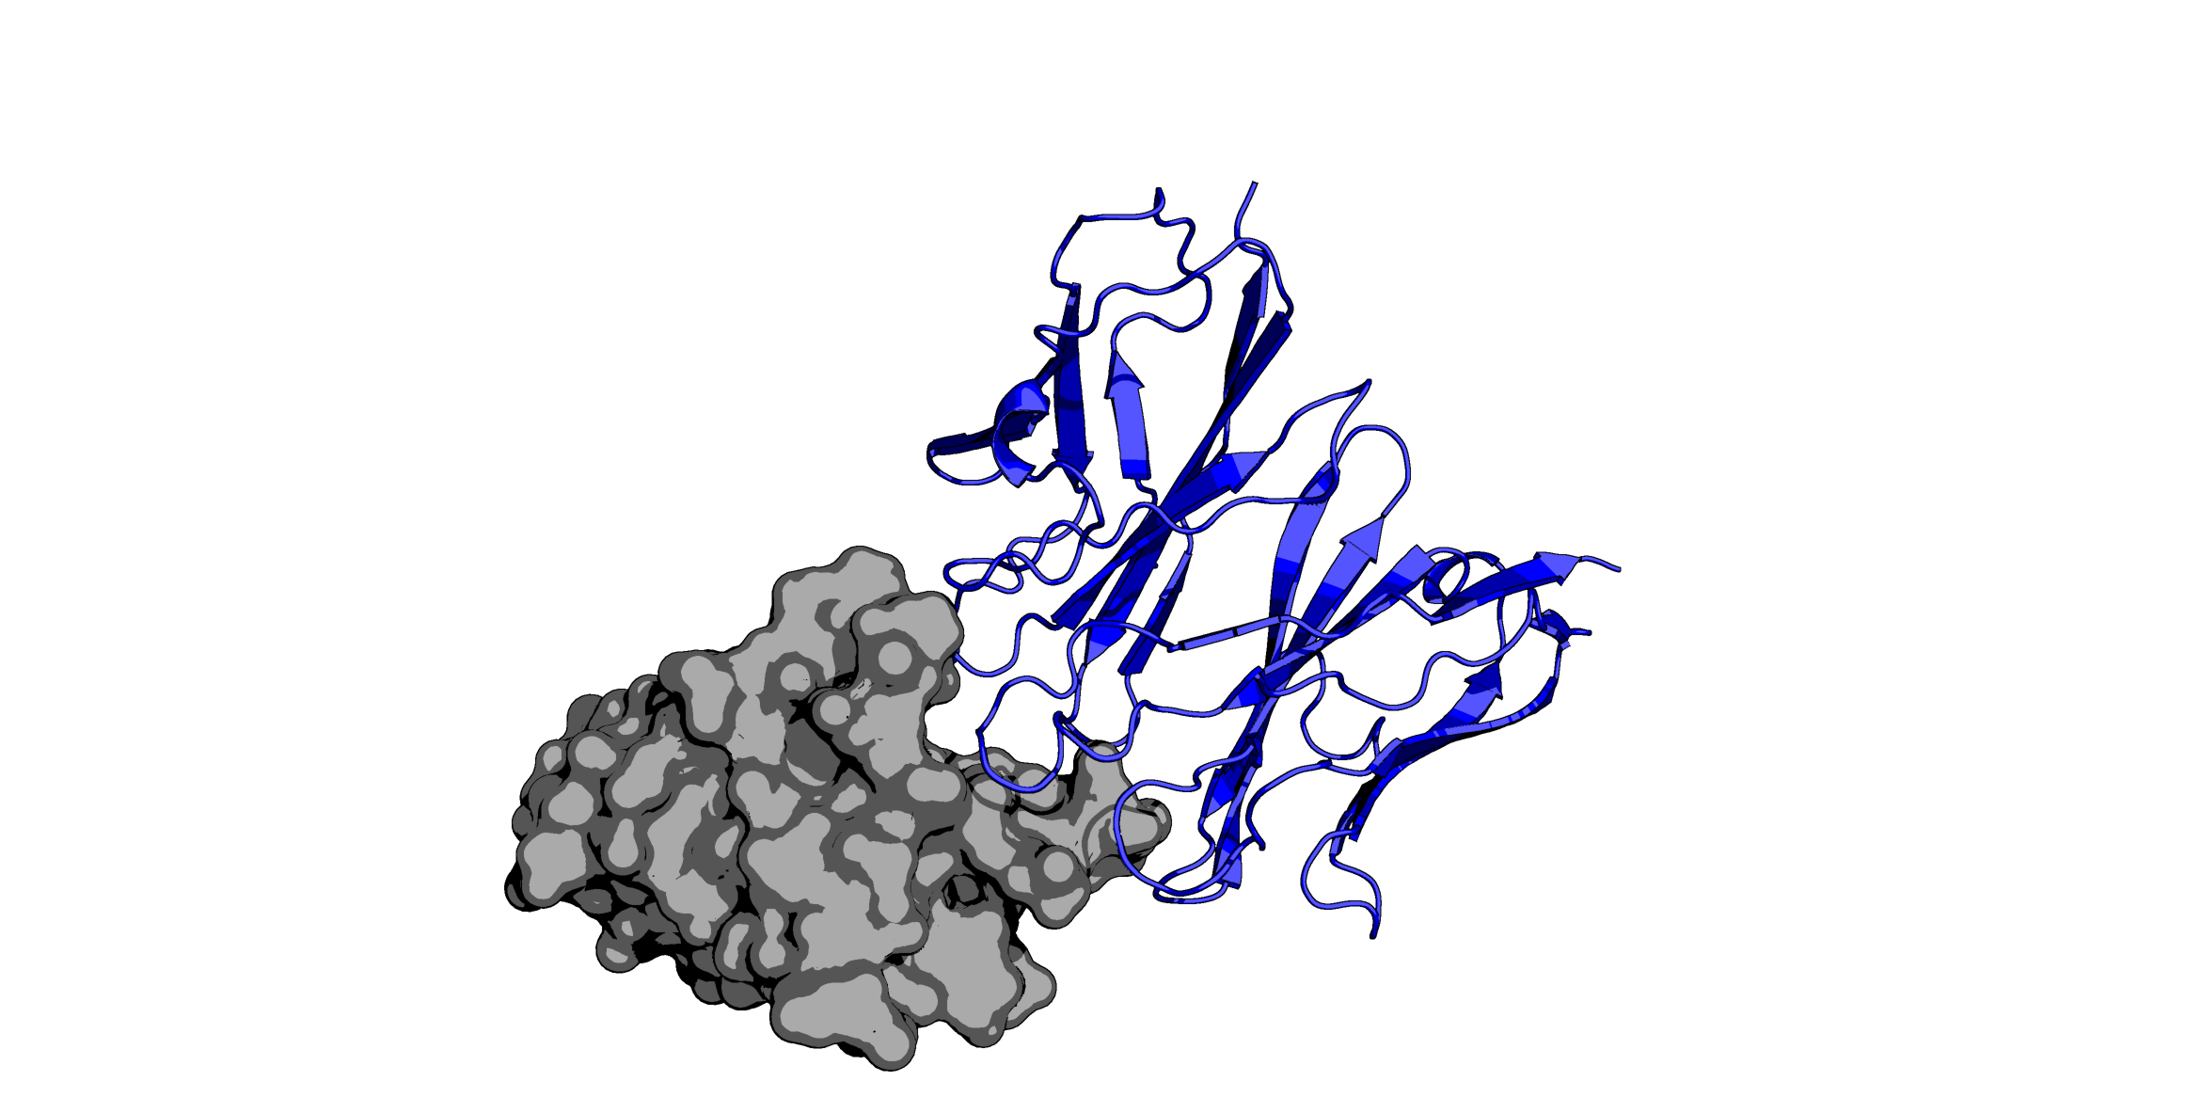
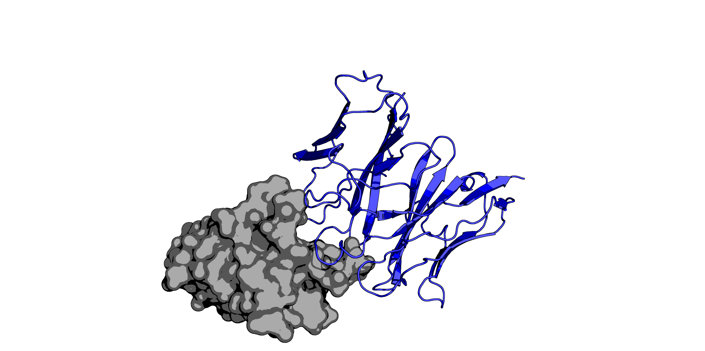
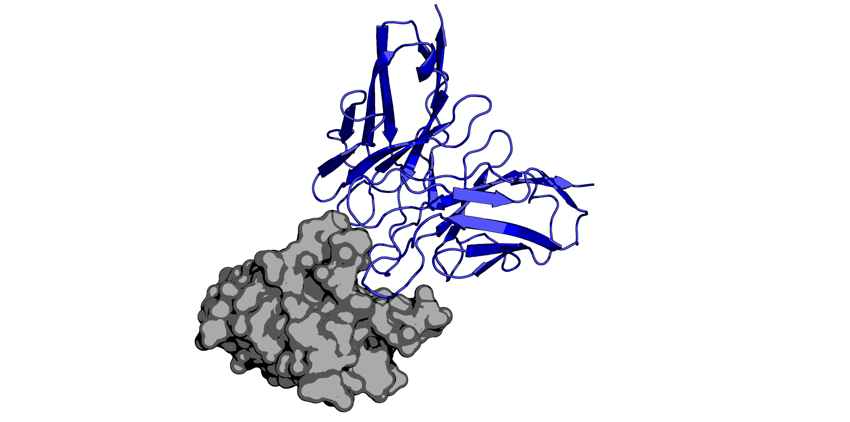
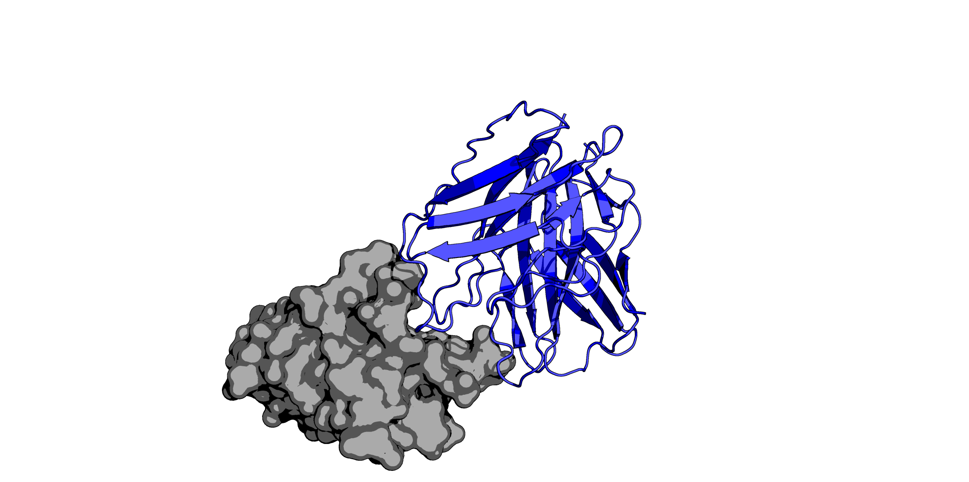
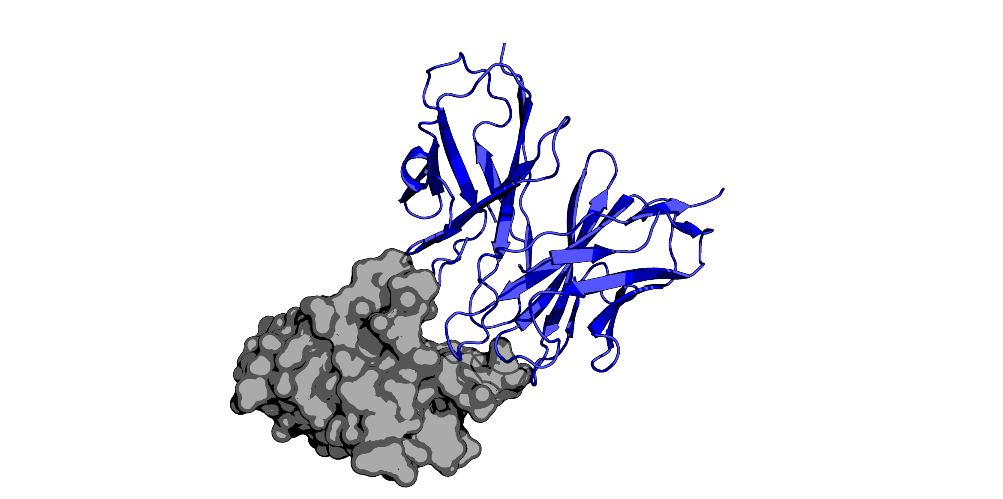
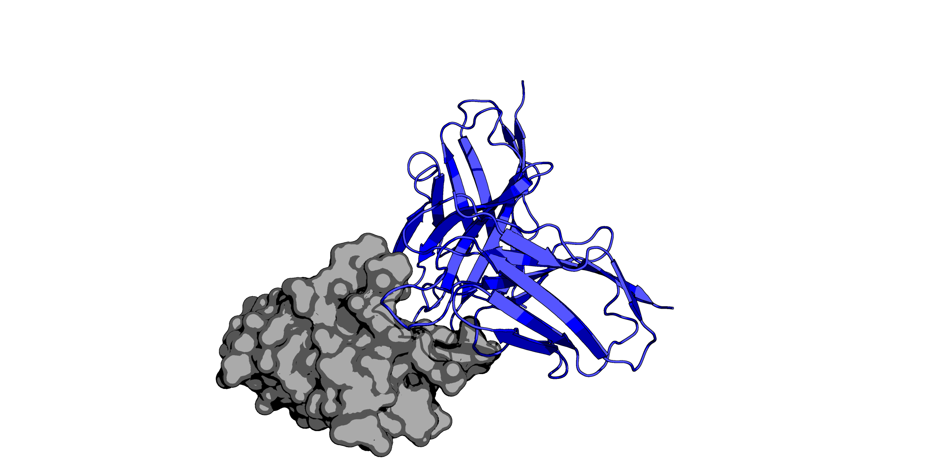
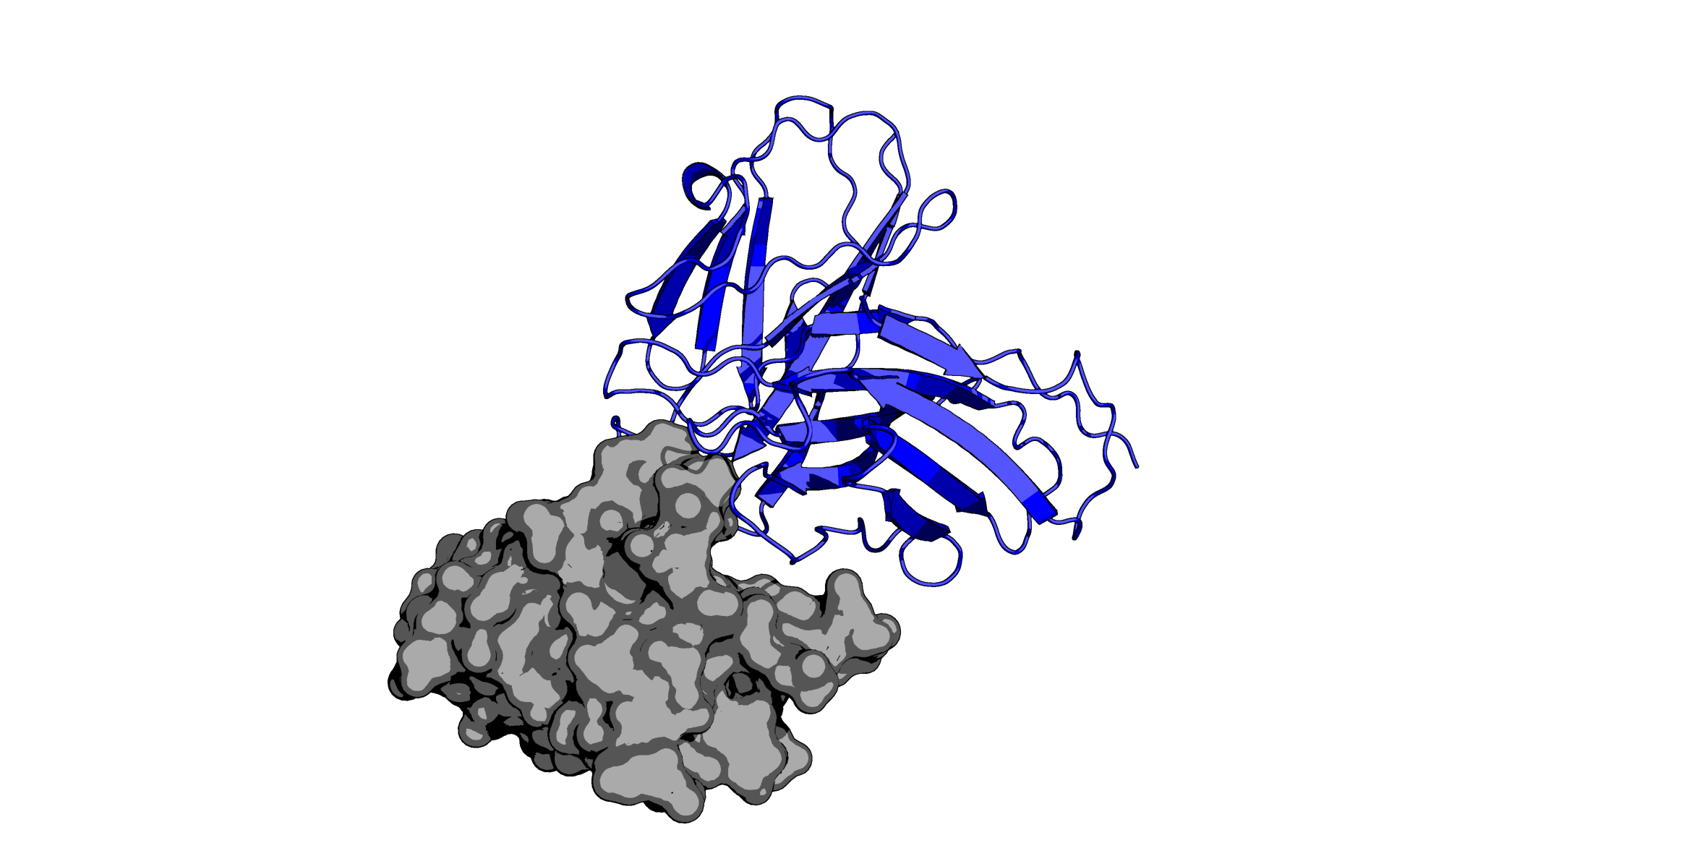
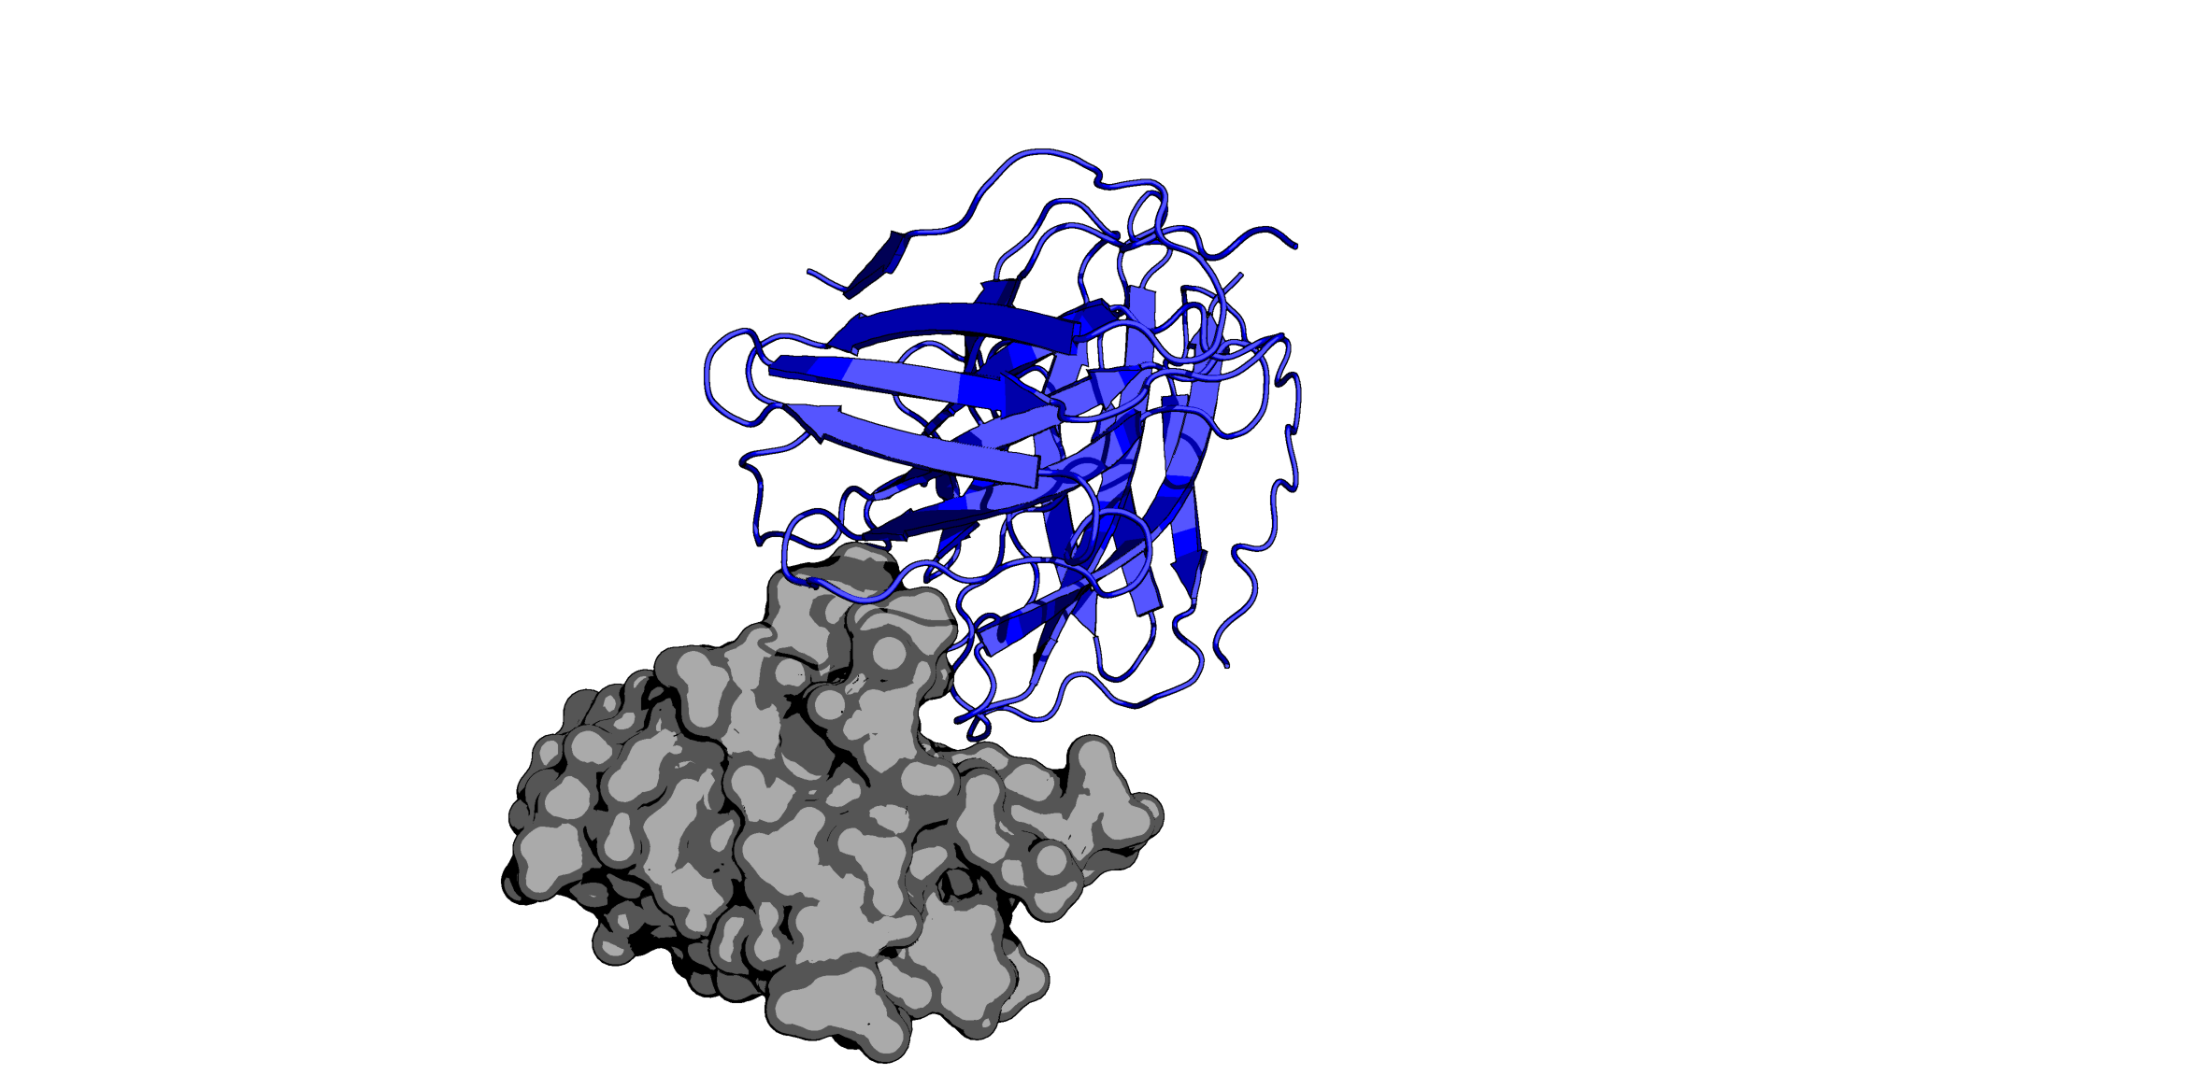
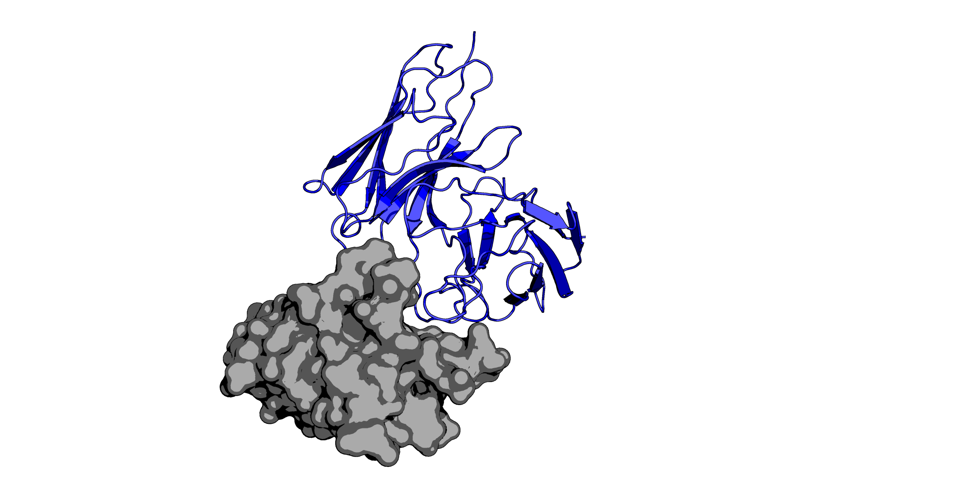
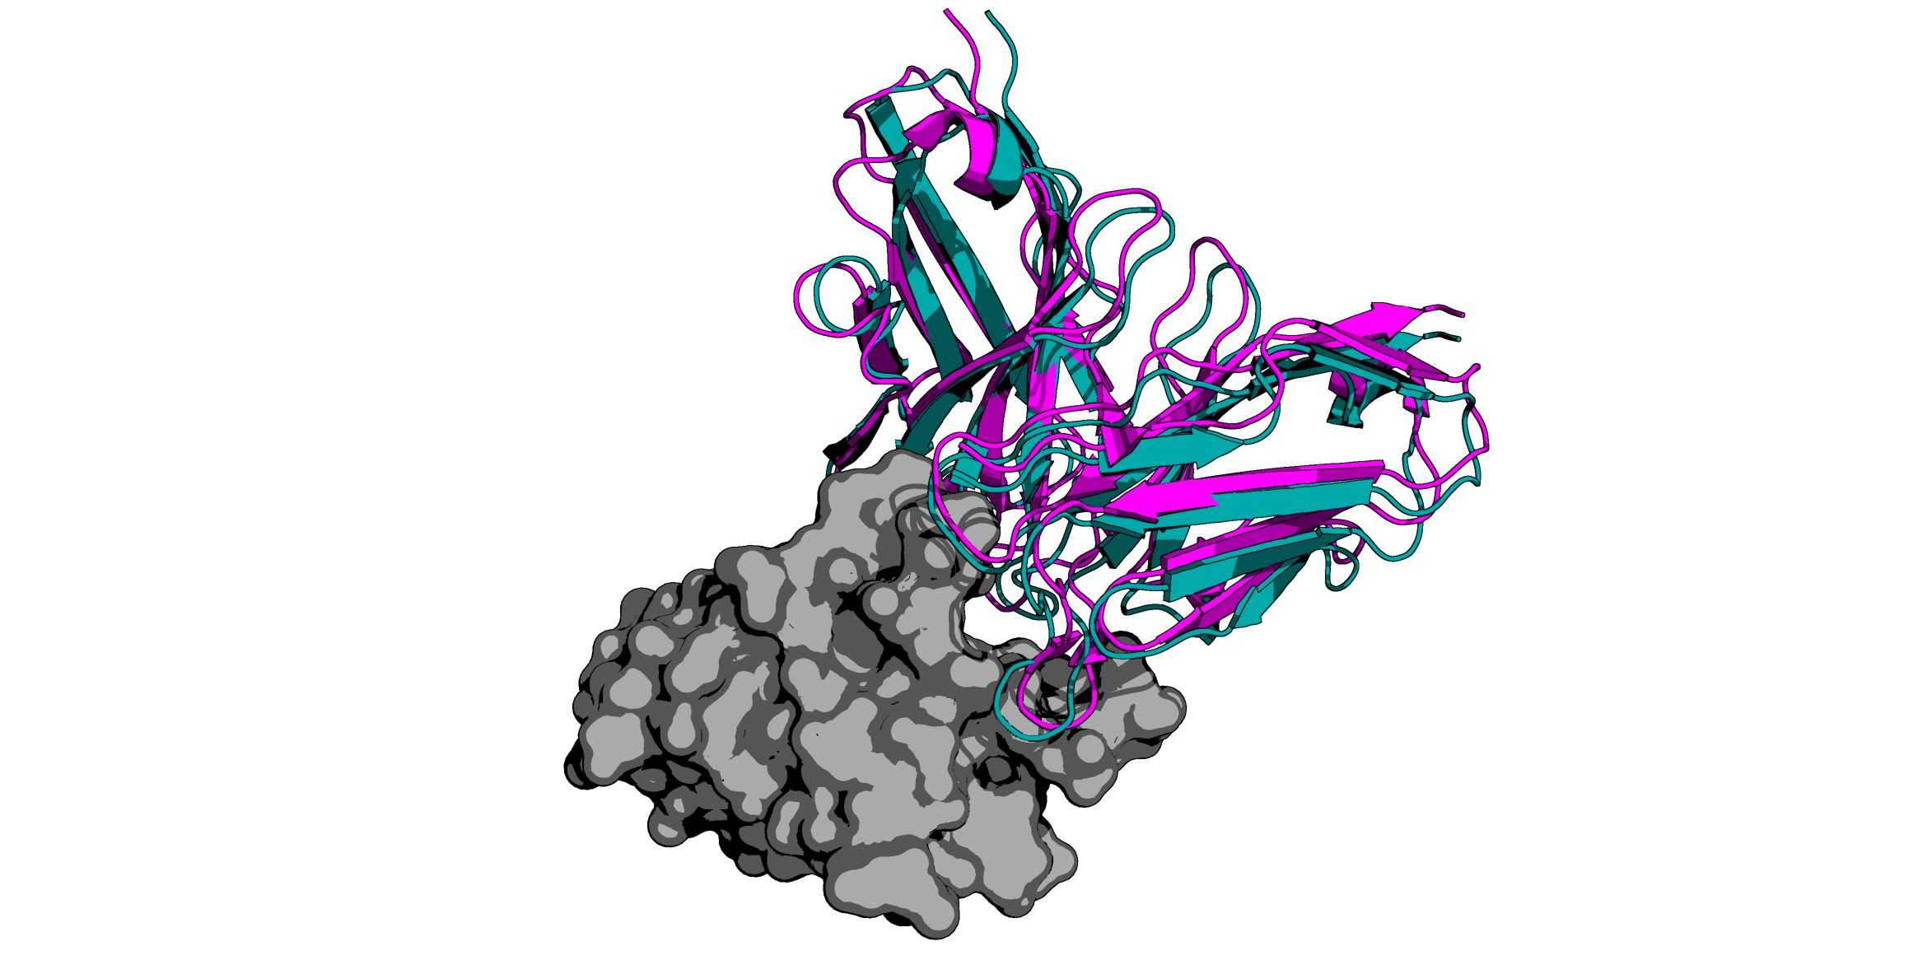
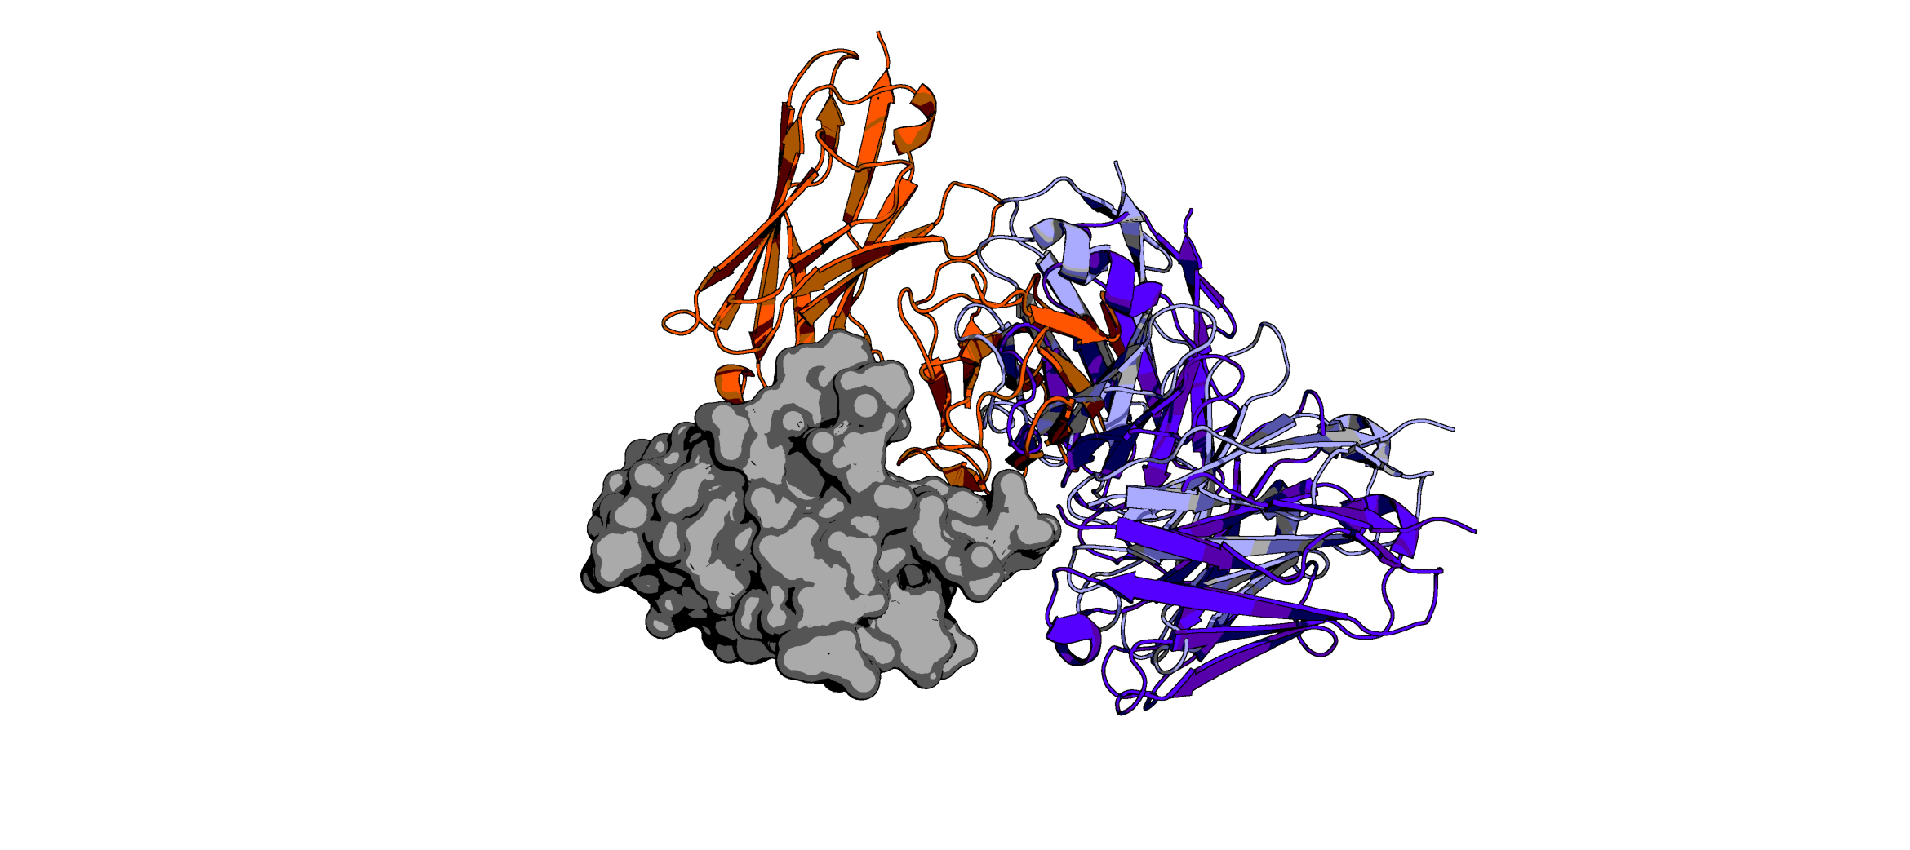
TUPPD1-001
TUPPD1-002
TUPPD1-003
Predicted
Predicted
Predicted
TUPPD1-004
TUPPD1-005
TUPPD1-006
Predicted
Predicted
Predicted
TUPPD1-007
TUPPD1-008
TUPPD1-009
Predicted
Predicted
Predicted
Pembrolizumab
Nivolumab
PDB: 5JXE
Predicted
PDBs: 5GGR and 5WT9
Predicted

Slide 2
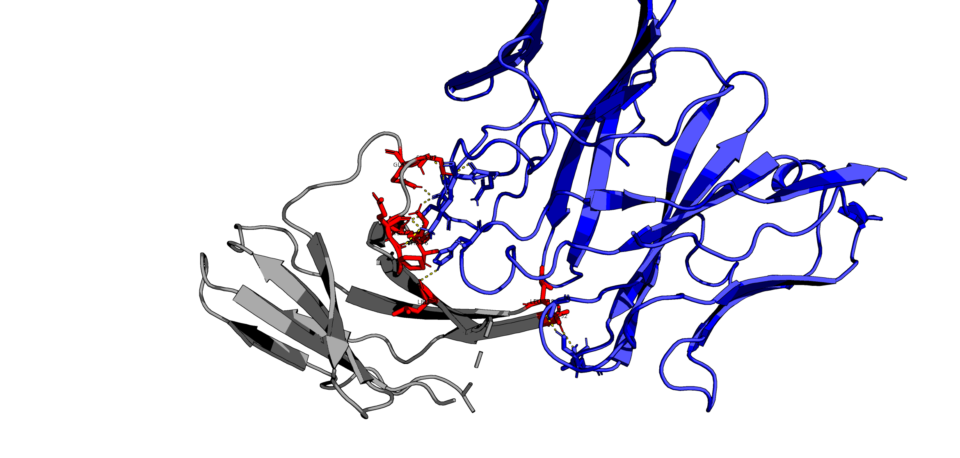
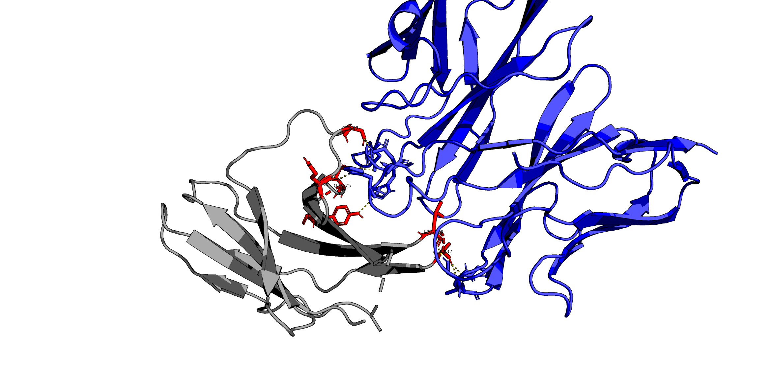
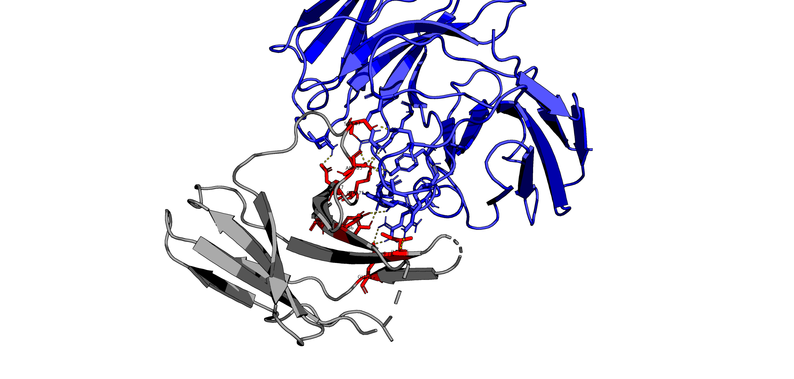
TUPPD1-001
GLN88
SER87
LYS78
THR76
LEU65
LEU128
ALA132
Predicted
TUPPD1-002
SER87
GLU84
GLN75
TYR68
LEU128
ALA132
Predicted
TUPPD1-009
SER87
ASP77
ASP85
GLN75
TYR68
ASN66
ILE126
GLU136
Predicted

Slide 3
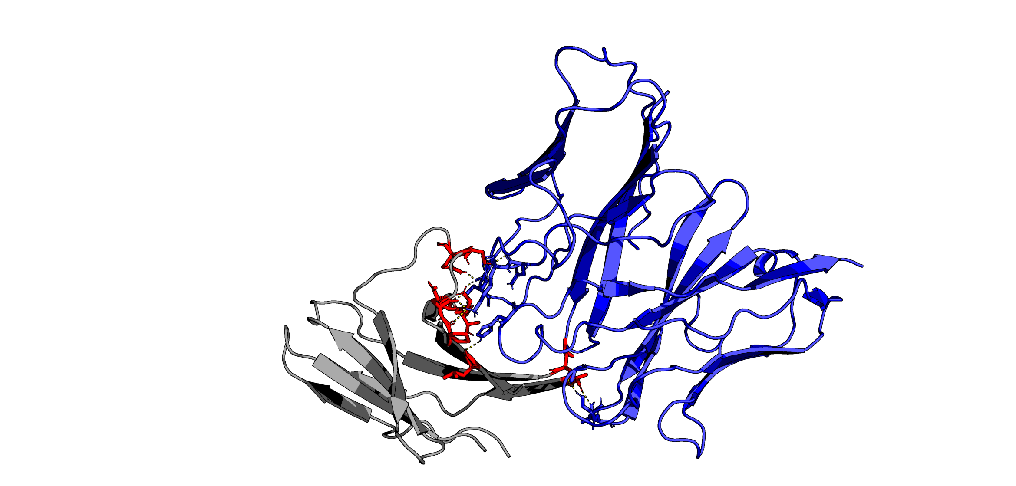
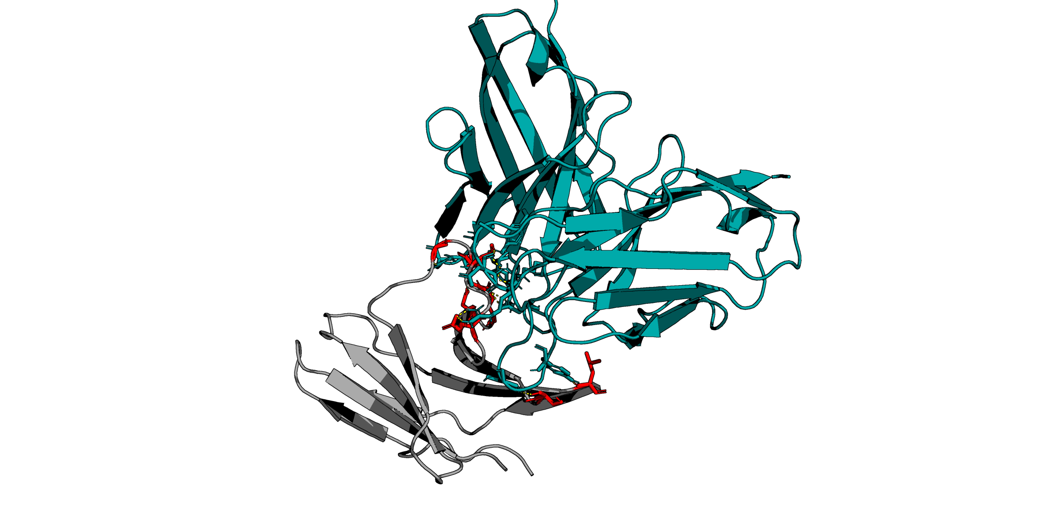
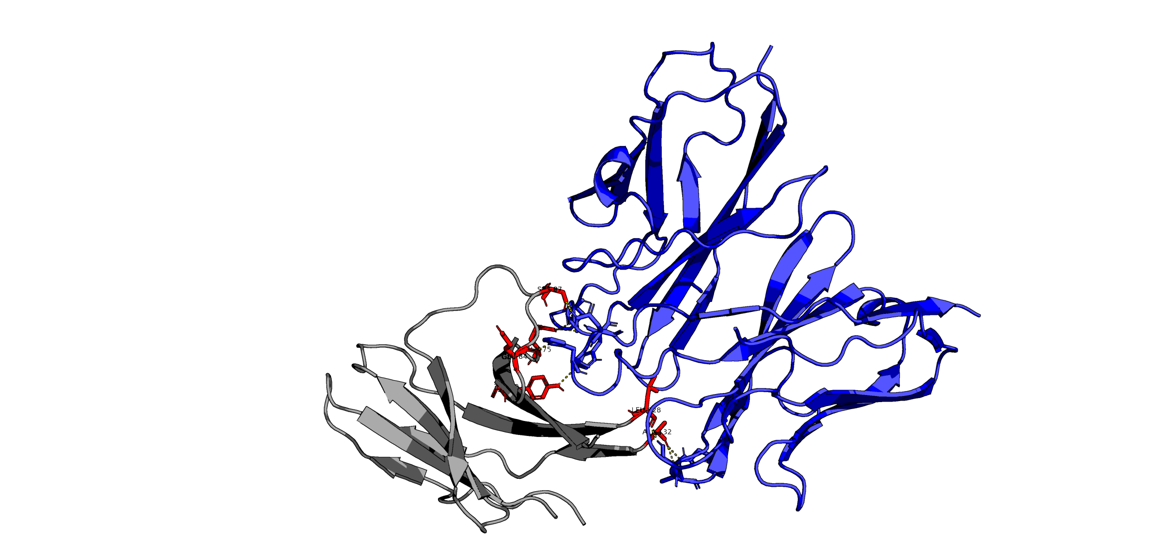
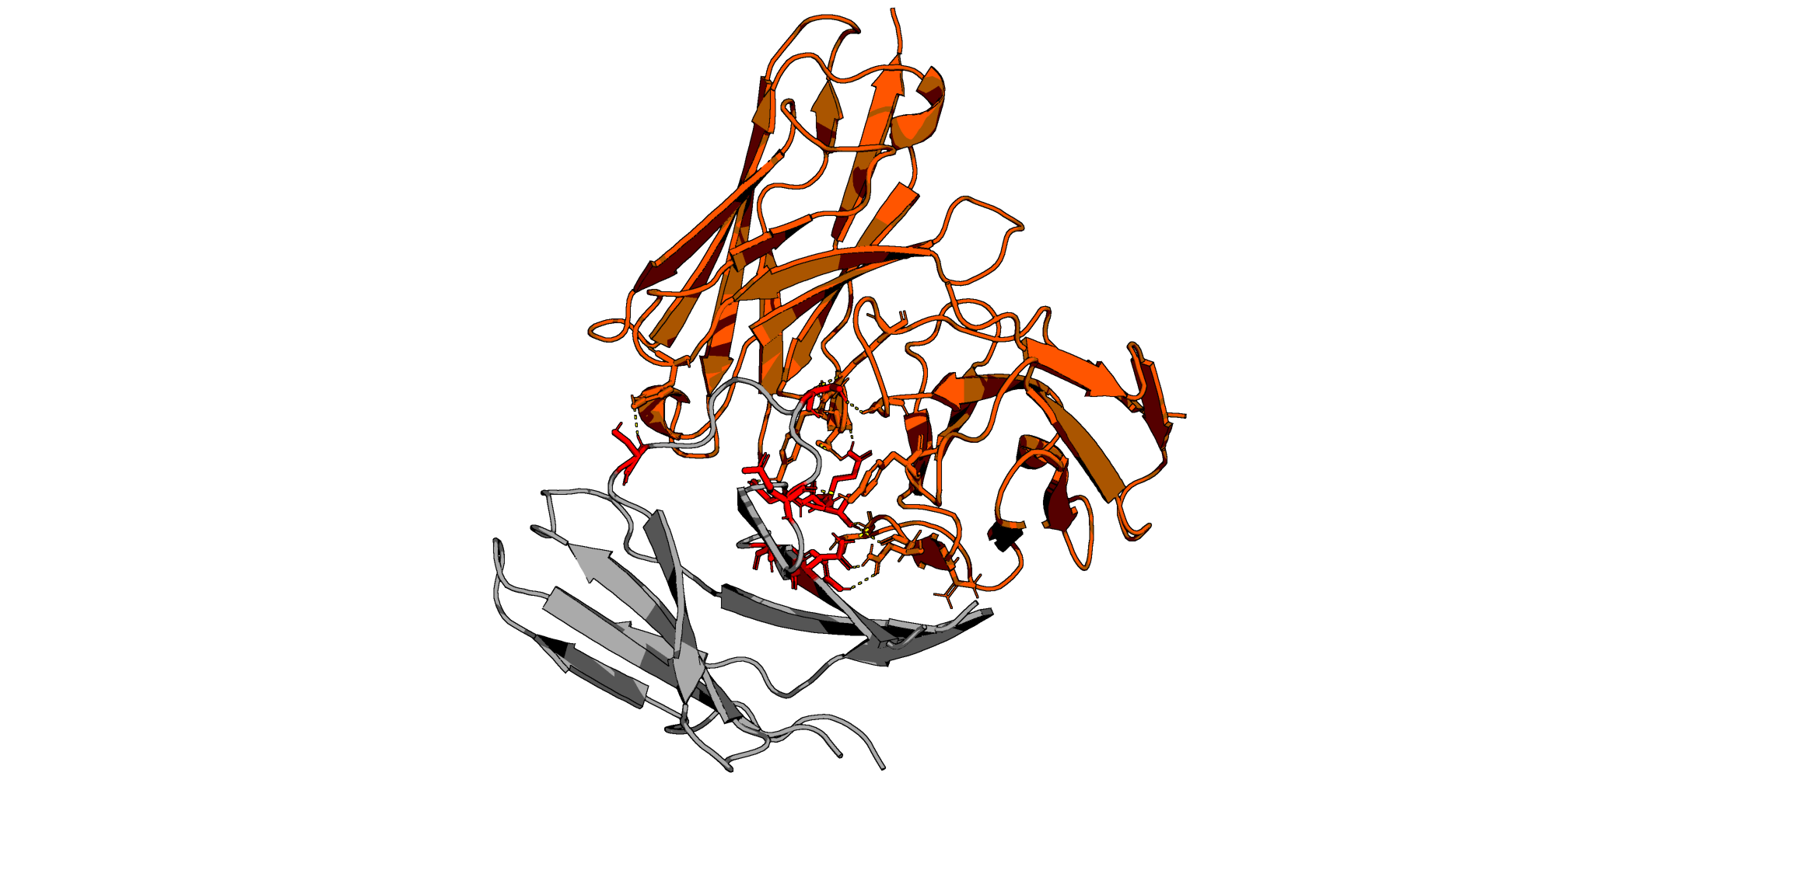
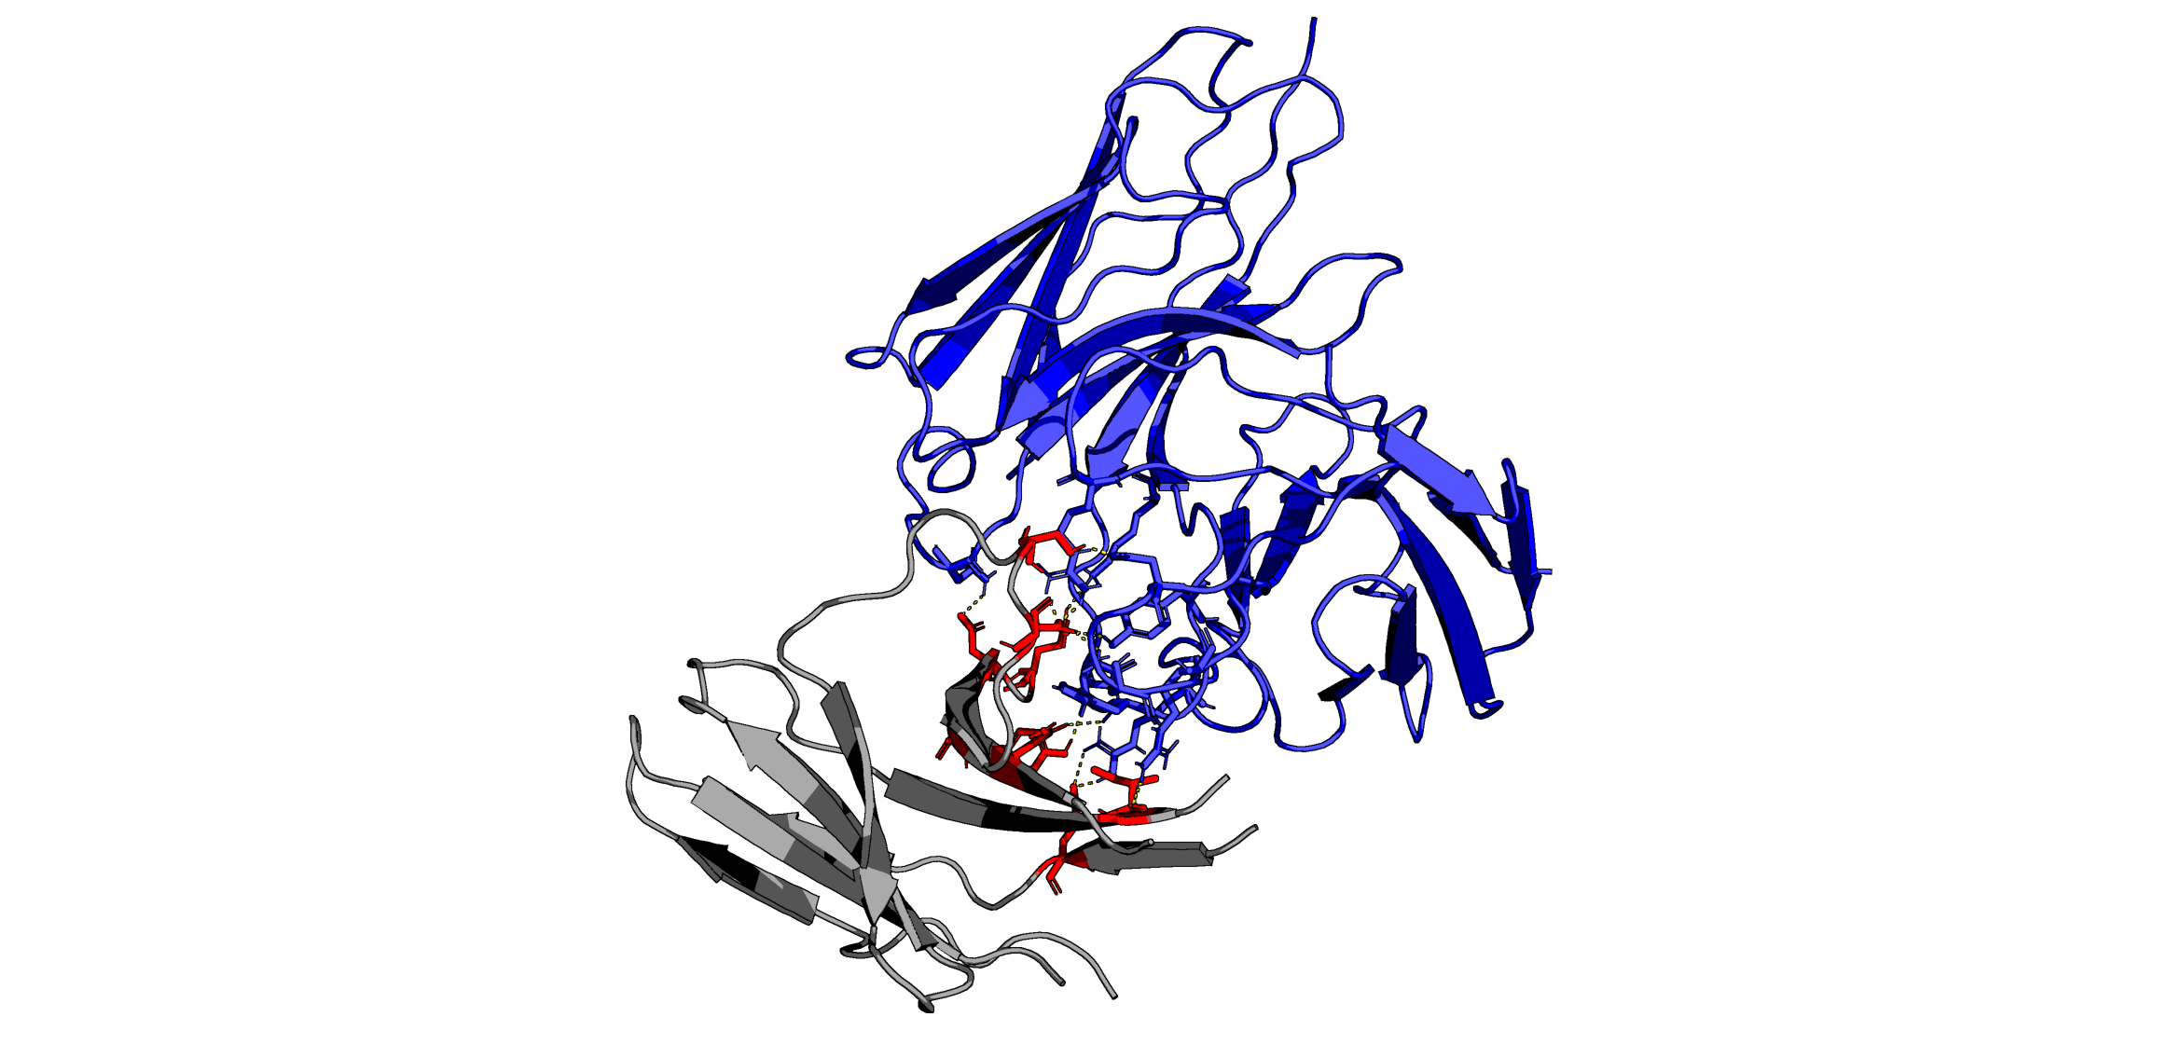
TUPPD1-001
Common PD-1 Interfaced Residues:
Pembrolizumab
GLY90
GLN88
SER87
GLN88
SER87
ASP77
GLN75
LYS78
GLU84
THR76
LEU65
LEU128
LEU128
ALA132
SER62
Predicted
Predicted
TUPPD1-002
Nivolumab
SER87
SER87
SER93
GLU84
GLN75
GLU84
GLN75
ASP77
THR76
TYR68
ASN66
LEU128
TYR68
ALA132
Predicted
Predicted
TUPPD1-009
SER87
ASN66
TYR68
GLN75
ASP77
ASP85
GLU84
SER87
GLN88
GLN75
TYR68
ASN66
LEU128
ILE126
GLU136
Predicted

